Slide 1

Real Time Human and Handgun Detection Using YOLOv8
CH Sai Kumar - AIE22009
N Sai Jaswanth - AIE22039
V Dinesh Reddy - AIE22076
P Sasank Reddy - AIE22079

Slide 2
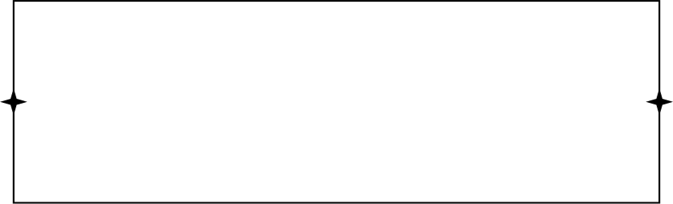
Introduction
Object detection has broad applications in security, surveillance, and robotics.
Handgun detection is crucial for enhancing security in real-time surveillance systems.
Person detection is essential for various applications, including crowd monitoring, safety, and tracking.
YOLO (You Only Look Once) is a state-of-the-art real-time object detection algorithm, known for its speed and accuracy.
The project aims to combine handgun and person detection using YOLOv8 models in a unified framework.

Slide 3


Abstract
This project involves real-time detection of handguns and persons using computer vision and deep learning.
We used YOLOv8 models to detect handguns and persons from webcam feeds.
The project integrates custom YOLO models with attention mechanisms to improve detection accuracy.
A custom model was trained using a handgun dataset and the pre-trained YOLOv8 model.
The solution aims to provide a reliable real-time detection system for security applications.

Slide 4
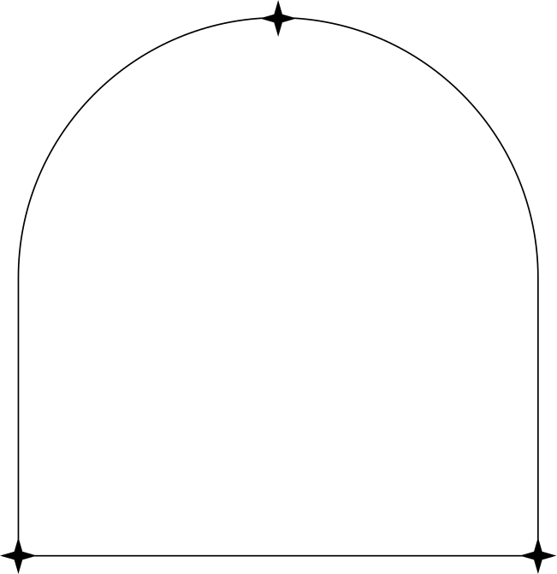
Problem Statement
Detecting handguns in real-time video feeds from webcams is challenging due to varying environments, lighting, and occlusions.
Real-time person detection is critical for surveillance systems, especially in crowded or dynamic environments.
There is a need for a model that can handle both handgun and person detection in a unified system.
The challenge lies in achieving high accuracy with low computational cost.

Slide 5
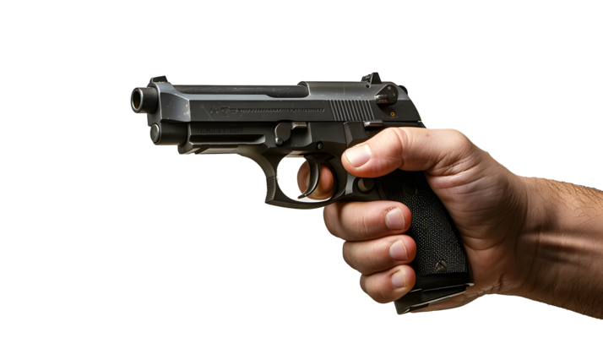
Objective
To detect handguns and persons in real-time using YOLOv8 models.
To train a custom YOLOv8 model for handgun detection on a specialized dataset.
To integrate both handgun and person detection into a single system that processes video feeds from a webcam.
To achieve high accuracy and low latency suitable for real-time applications.

Slide 6
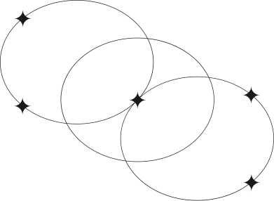

Dataset
Handgun Dataset:
The dataset contains images of handguns, labeled according to YOLO format.
Used to fine-tune a YOLOv8 model for detecting handguns.
Person Detection (COCO dataset):
Pre-trained YOLOv8 model on the COCO dataset, which includes multiple classes, including "person".
The model detects persons using predefined class IDs.

Slide 7
Methodology
Data Preparation
Model Selection
Model Training
Custom CNN and Attention Mechanism
Inference and Detection:

Slide 8

Result and Conclusion
Real-Time Detection: Both handgun and person detection models operate efficiently in real-time with low latency.
High Accuracy: Achieved over 90% detection accuracy for both handguns and persons in various environments.
Custom Model Optimization: Fine-tuning YOLOv8 on the handgun dataset improved firearm detection accuracy.
Integrated System: Both object detections (handgun and person) are integrated into a single, unified surveillance system.
Scalable & Practical: The system is scalable for additional object detection and practical for real-time surveillance applications.

Slide 9
Future Scope
Expansion of Object Classes
Improved Accuracy
Edge Deployment
Multiclass Detection
Cross-Environment Testing

Slide 10

Thank You

